Slide 1
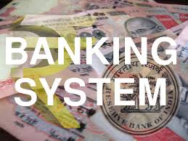





BANKING SYSTEM
Made By - Divya 22csu060
Erica 22csu065
Garima 22csu068

Slide 2
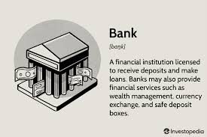
INTRODUCTION
Banking is an industry that handles cash, credit, and other financial transactions. Banks provide a Safe place to Store extra cash and credit.They offer savings accounts, Certificates of Deposit, and checking accounts. Banks use these deposits to make loans. These loans include home mortgages, business loans, and car loans.

Slide 3

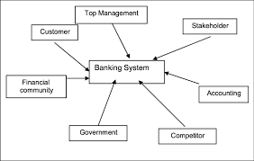
Banking is an integral part of the whole financial system. It affects the country’s economy by providing investment, credit, and infrastructure. The banking industry is the backbone of global economies. The banking sector plays a significant role in the economic growth and development of any country.The introduction of the banking industry highlights the importance of the banking sector in developing countries, especially rural areas where traditional financial institutions are less developed, and there is a need for change.

Slide 4


Slide 5
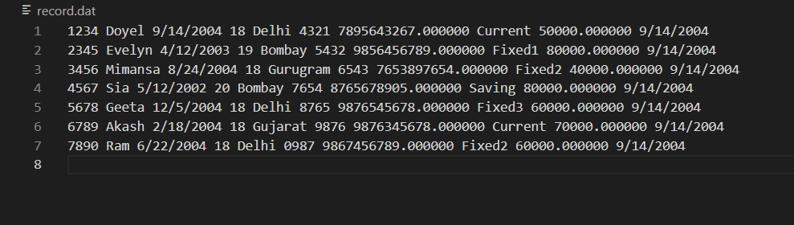
A file is created with the name record.dat

Slide 6
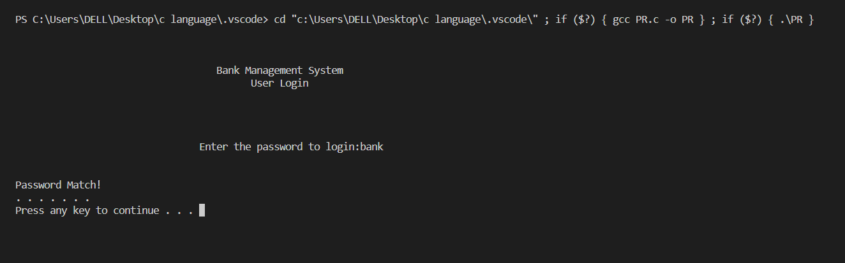
User Login

Slide 7
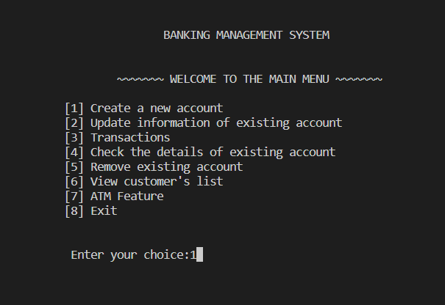
Main Menu

Slide 8
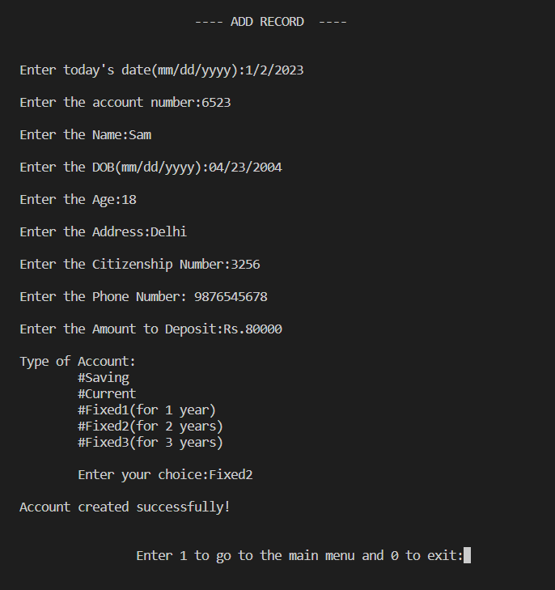
Creating a new account

Slide 9
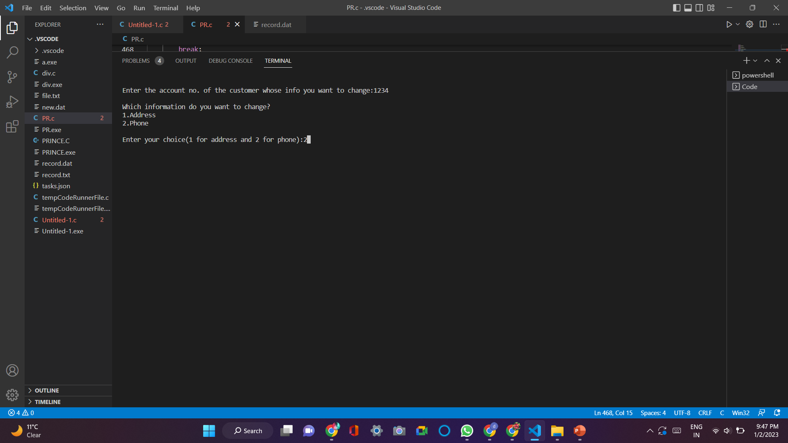
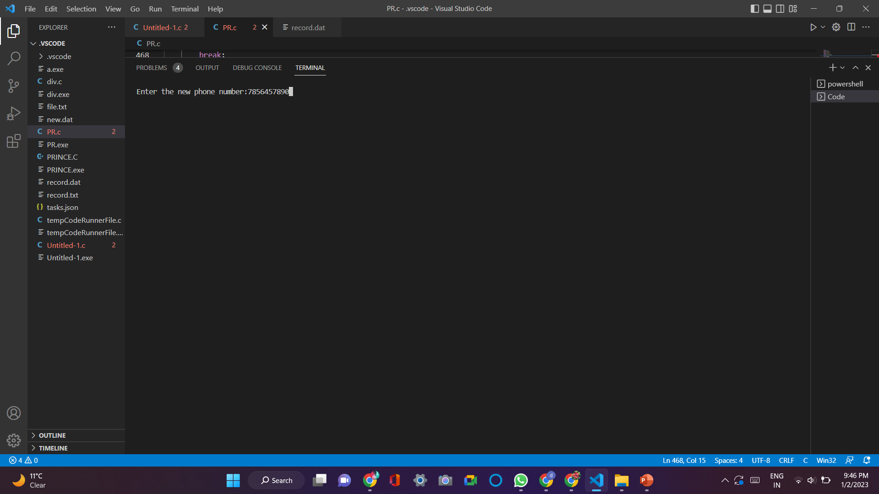
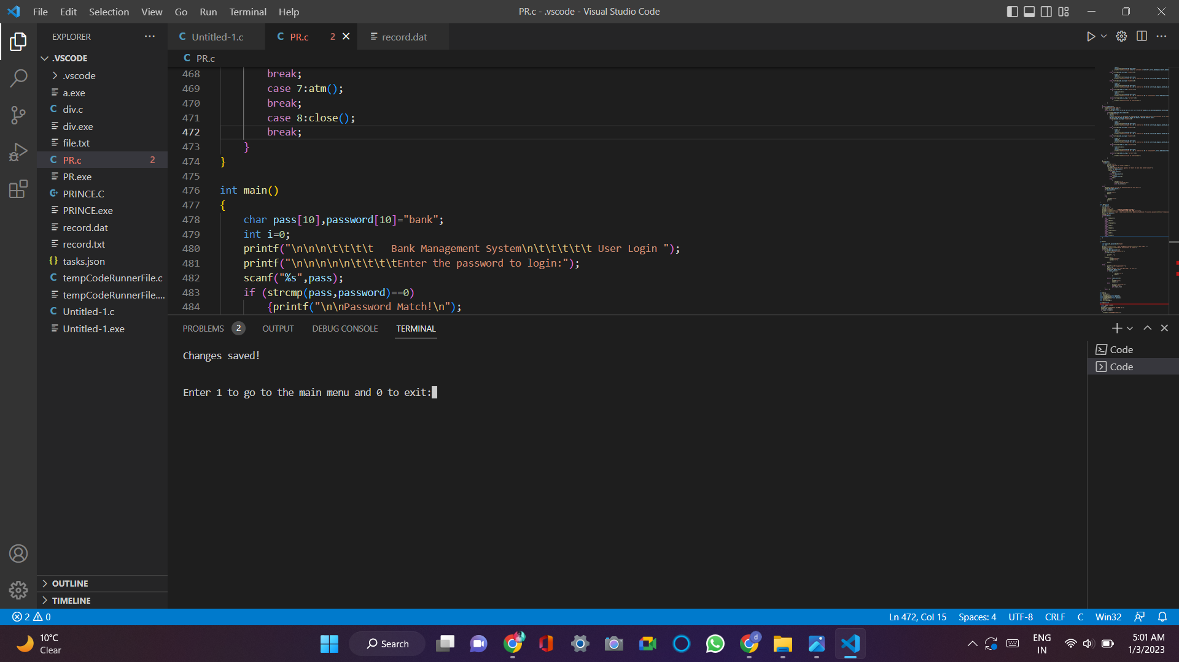
2. Update the info of existing account

Slide 10
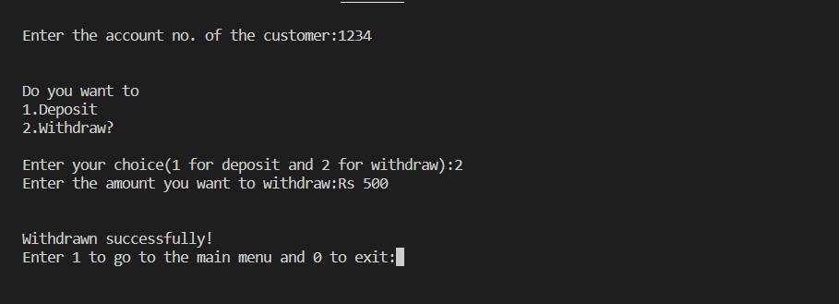
3. Transactions

Slide 11
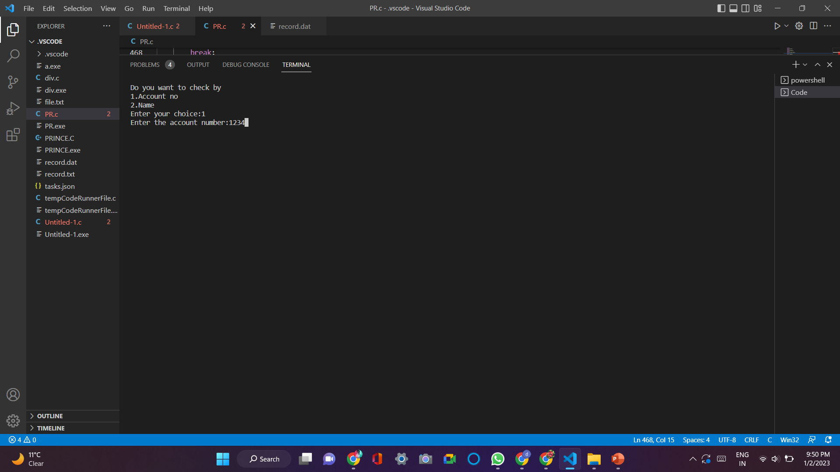
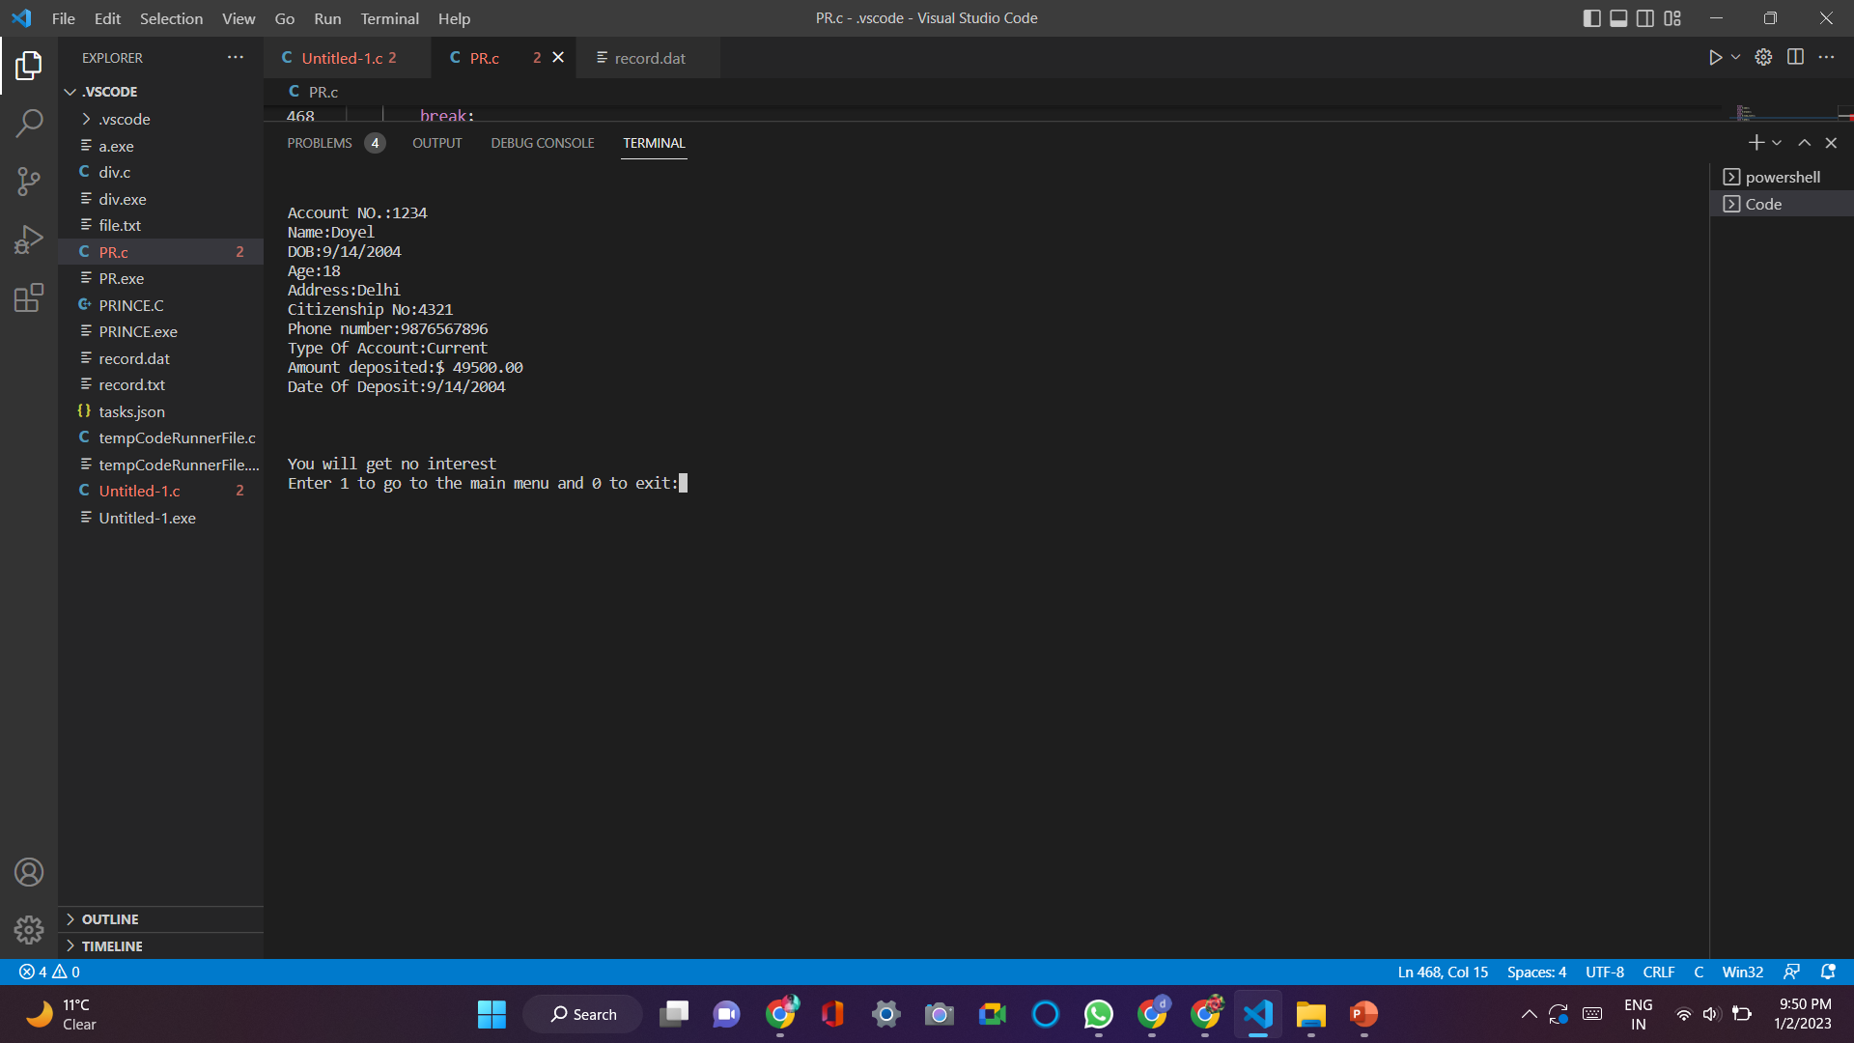
4. Check the Details of Existing Accounts

Slide 12
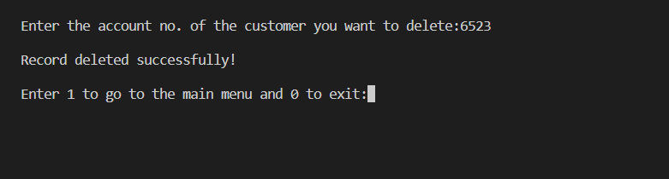
5. Remove the existing Account

Slide 13
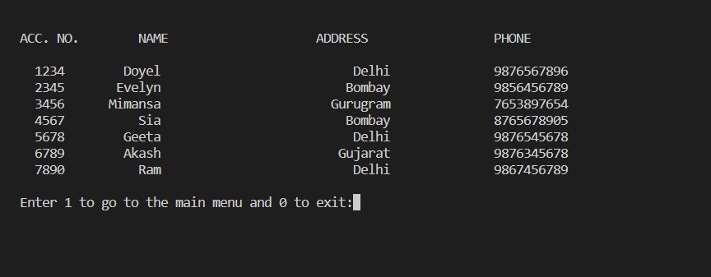
6. View customer’s List

Slide 14
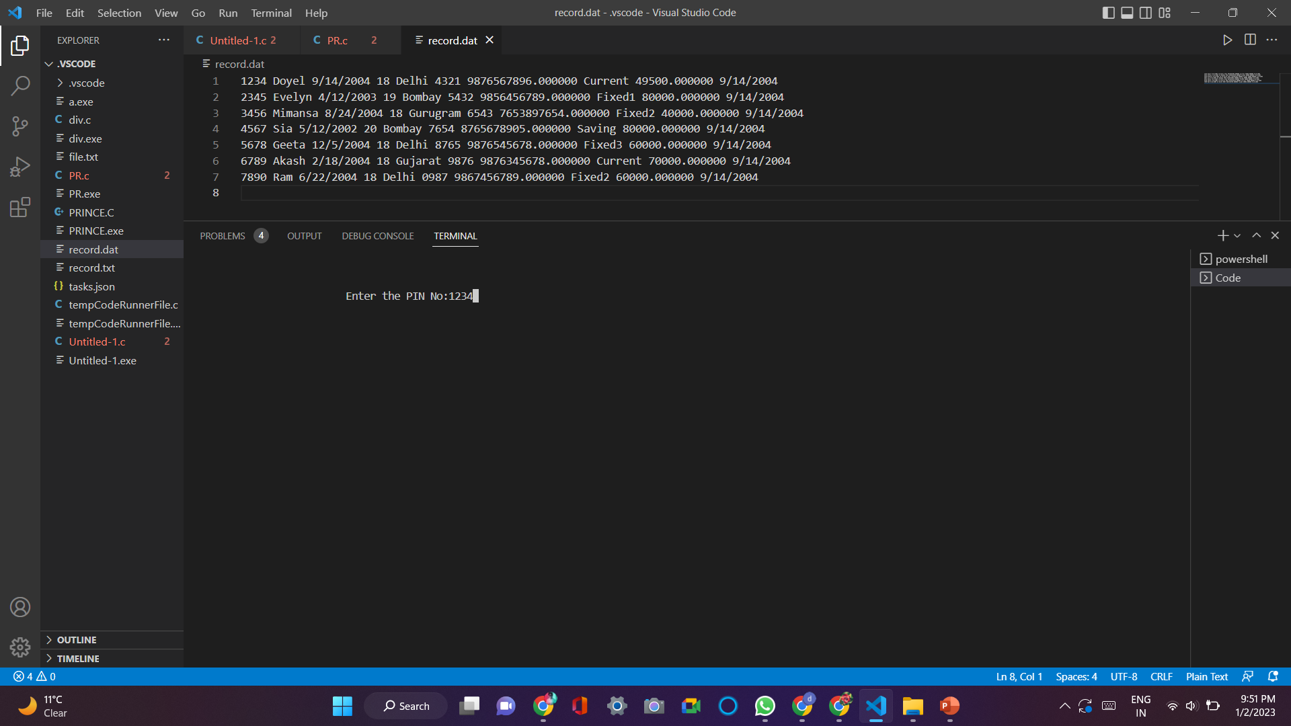
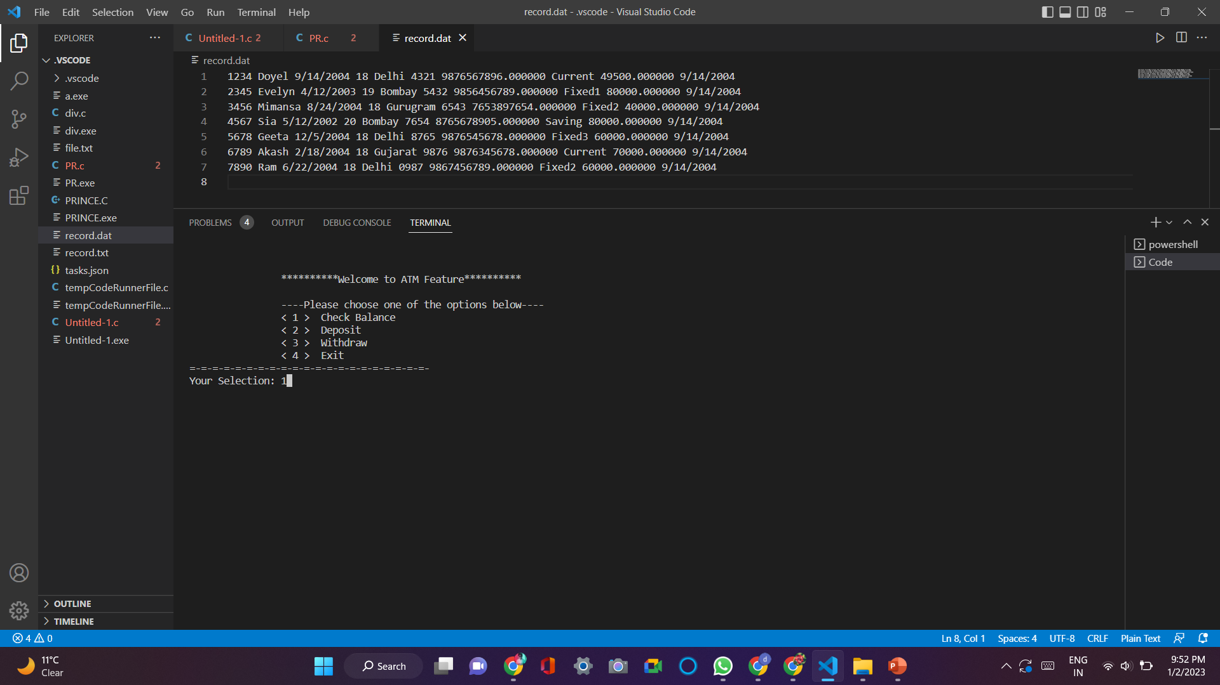
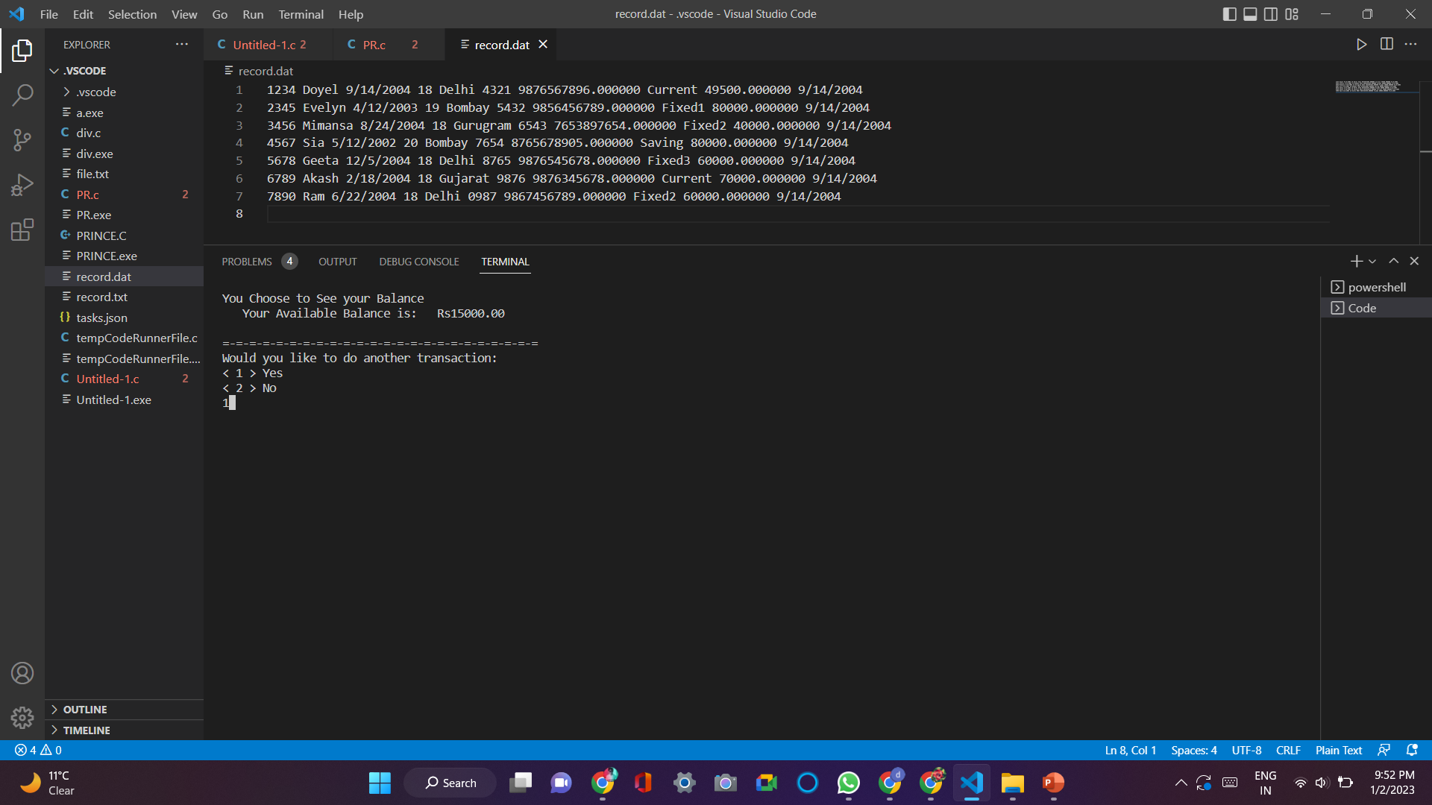
7 ATM Feature

Slide 15

Future Extensions that can be added
E- Banking
Using details of a) Adhaar Card
b) PAN Card
c) Email Address

Slide 16
List of References
https://www.codewithc.com
https://www.geeksforgeeks.org
https://github.com
http://www.cprogrammingnotes.com

Slide 17


